Slide 1

Introduction to Biology for Engineers
SAlAI MADHAVI R
Department of ISE
CMRIT,Bengaluru

Slide 2

Faculty details-
SALAI MADHAVI R
Department of ISE
CMRIT,Bengaluru
Google Classroom class code- xsq5o6t

Slide 3

Agenda
3
Day-01
Introduction
Student perspective
Introduction to subject
Why subject is important
Real World Applications
Course Objectives
Pre-requisites
Course Outcomes
CO-PO mapping
Quiz
Day-02
Textbooks and Reference books
Lesson Plan
Assessment Plan
Experience of past batch students
Expected classroom behavior
Some useful links

Slide 4
Course Objectives
To familiarize the students with the basic biological concepts and their engineering applications.
To enable the students with an understanding of bio-design principles to create novel devices and structures.
To provide the students an appreciation of how biological systems can be re-designed as substitute products for natural systems.
To motivate the students to develop interdisciplinary vision of biological engineering.

Slide 5
Course Outcomes
Elucidate the basic biological concepts via relevant industrial applications and case studies.
Evaluate the principles of design and development, for exploring novel bioengineering projects.
Corroborate the concepts of biomimetics for specific requirements.
Think critically towards exploring innovative biobased solutions for socially relevant problems.

Slide 6
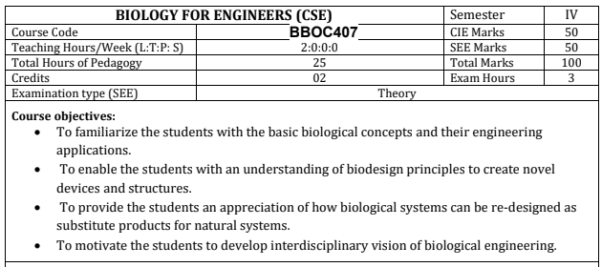

Slide 7
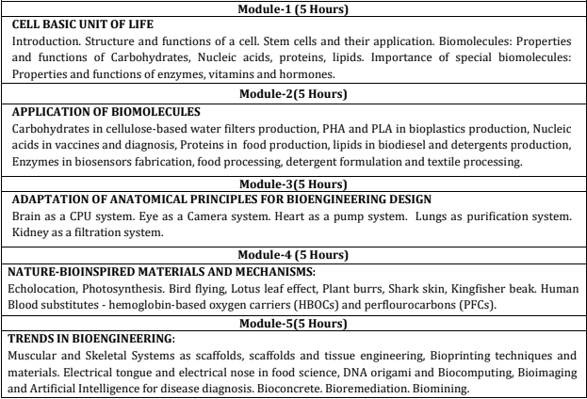

Slide 8
Text books
Biology for Engineers, Rajendra Singh C and Rathnakar Rao N, Rajendra Singh C and Rathnakar Rao N Publishing, Bengaluru, 2023.
Human Physiology, Stuart Fox, Krista Rompolski, McGraw-Hill eBook. 16th Edition, 2022
Biology for Engineers, Thyagarajan S., Selvamurugan N., Rajesh M.P., Nazeer R.A., Thilagaraj W., Barathi S., and Jaganthan M.K., Tata McGraw-Hill, New Delhi, 2012.
Biology for Engineers, Arthur T. Johnson, CRC Press, Taylor and Francis, 2011
Biomedical Instrumentation, Leslie Cromwell, Prentice Hall 2011.
Biology for Engineers, Sohini Singh and Tanu Allen, Vayu Education of India, New Delhi, 2014.
Biomimetics: Nature-Based Innovation, Yoseph Bar-Cohen, 1st edition, 2012, CRC Press.
Bio-Inspired Artificial Intelligence: Theories, Methods and Technologies, D. Floreano and C. Mattiussi, MIT Press, 2008.
Bioremediation of heavy metals: bacterial participation, by C R Sunilkumar, N GeethaA C Udayashankar Lambert Academic Publishing, 2019.

Slide 9
Assessment plan(VTU)
9
Max marks 50
Min marks 20
Continuous Evaluation(Internal Tests) | 3
No. of internal tests | 03
Max. marks for each test | 50
Internal tests marks are reduced to (by taking avg. of three tests) | 25
Max. Marks for Assignment | 25
Min. no. of assignments 03 | 03
Max. Marks for each assignment 10 | 25
Assignment marks are reduced to (Avg. of all assignments) | 25
*

Slide 10
NEED FOR BIOLOGY
The previous few centuries saw a better fundamental understanding of the physical and chemical world through advances in physics and chemistry.
The better understanding and advances gave rise to technologies and products, such as computers, communication devices, aircraft, and others that revolutionized life.
Since this is the century of biology, a similar phenomenon is expected, which will lead to probably another revolution.
Many engineers are expected to contribute to a biological aspect to fuel this revolution.
Therefore, the engineering undergraduates need to be suitably exposed atleast to the very minimum biology.
So that they would atleast be able to consider a biological system/aspect in which they could later make appropriate contributions, through their main expertise, say electrical engineering, mechanical engineering, computer science, materials engineering, or any other.

Slide 11
Why do engineers need to study the principles of biology?
Principles of mechanics applied to understand biological systems.
Biomechanics – is the application of mechanical principles in the study of living organisms including their kinematics and kinetics, it views human body as a collection of levers, made of bones which are moved by its muscles. In sport, used to analyze the performance level of athletes. Focuses on body segments and its interaction with the surrounding environment.
Understanding Pharmacokinetics and Pharmacodynamics of medicines.

Slide 12
Why do engineers need to study the principles of biology? cont.
Mechanobiology – in the level of cells – it dwells on the behavior of physical forces and transfer in cell and/ or tissues.
Nanotechnology – carbon nanotubes as drug delivery systems used in cancer therapy
Computational Fluid Dynamics (CFD) – an engineering tool that connects mechanics to mathematics and software programming to execute simulation performing how a fluid (liquid or gas) flows based on Navier-Stokes equations (used to describe the motion of viscous fluid substances).
Bionics or biologically inspired engineering is the application of biological methods and systems found in nature to the study and design of engineering systems and modern technology.

Slide 13
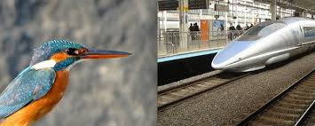
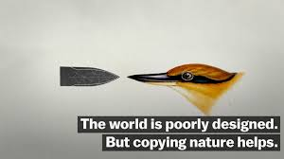
Shinkansen Sonic Boom
Many man-made things have significant scope for optimising their design. For example, Shinkansen, Japan’s high-speed bullet train, plays an important role in Japan with a coverage of close to 3000 km.

Slide 14
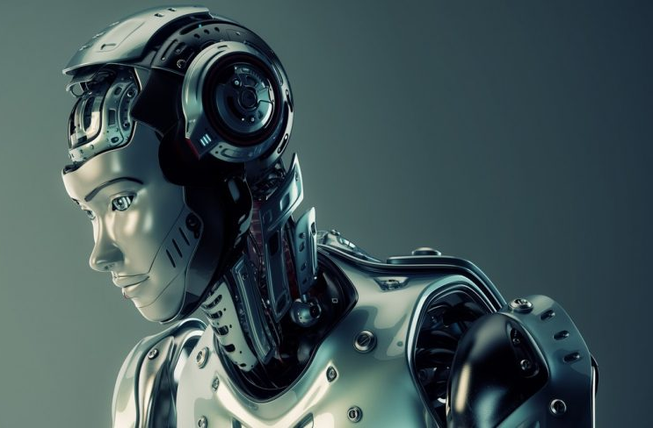
Bio-robotics
It refers to robots that are inspired by biological entities or the use of biological components in robots.
We are possibly familiar with the concept of bio-robotics from many sci-fi movies and TV shows, which show robots with human like features.

Slide 15
Biopolymer
Biopolymers are polymers that are produced by or derived from living organisms, such as plants and microbes, rather than from petroleum, the traditional source of polymers.
The primary sources of biopolymers are renewable.
Many biopolymers are biodegradable, but not all. Polythioesters are non-biodegradable by microorganisms, which represent a novel non-biodegradable bioplastic material.
Biopolymers consist of monomeric units that are covalently bonded to form larger molecules. There are three main classes of biopolymers, 1. polynucleotides, 2. polypeptides and 3. polysaccharides.

Slide 16
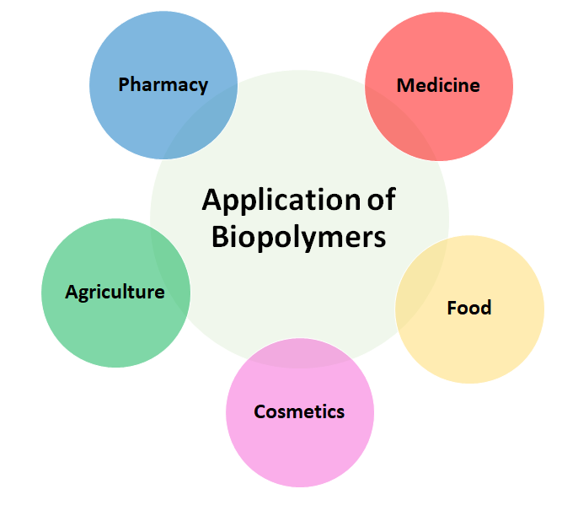
Drug delivery system
Microcapsules
Micro/Nano sphere
Liposome
Hydrogels
Medical application
Medical implants
Skin tissue repair
Antimicrobial membranes
Vascular grafts
Biosensors and diagnostics
Sustainable agro-practices,
Water recovery and soil conditioner
Agrochemicals delivery
Biosorbents
Super absorbents
Packing and agents for food emulsions
Edible encapsulated film
Coating
Emulsifers
Moisture retaining agents
Hydrogels in cosmetics
Skin care
Hair care
Mucous membrane care

Slide 17
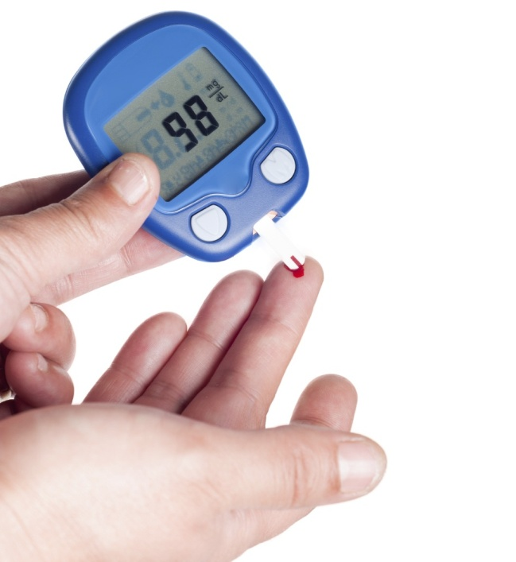
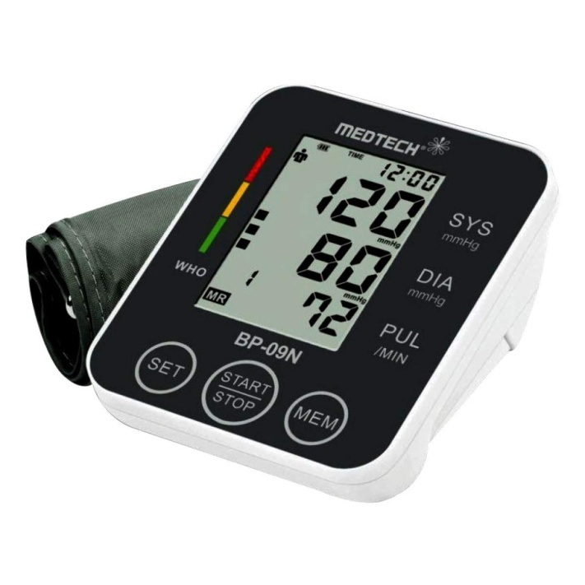
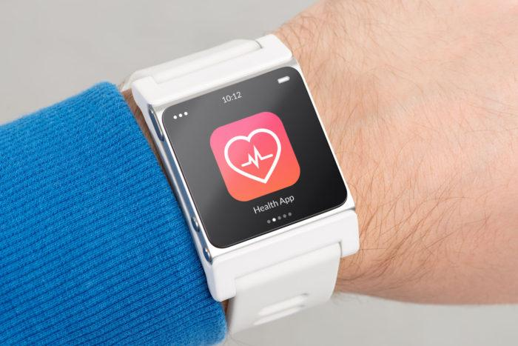
Hemoglobinometer
Electronic
Sphygmomanometer
Smart watch

Slide 18
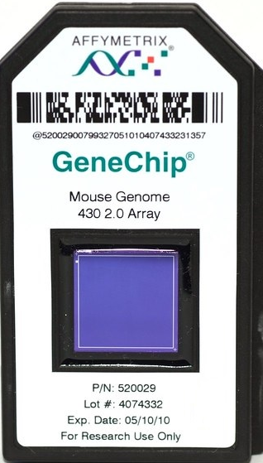
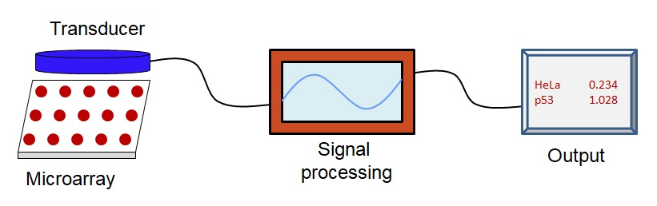
Bio-chips
Bio-chips are miniaturized laboratories in which thousands of biochemical reactions can be carried out simultaneously at micron scales for useful purposes such as disease studies or safety studies.
Biochips are engineered substrates underlying sensor technology.
Working principle
Genechip product contains thousands of individual DNA sensors use in sensing defect.

Slide 19
Bio-filters
Biofilters are technical applications that use the biofiltration process to remove pollutants in environment.
Biofiltration is a pollution control technique using a bioreactor containing living material to capture and biologically degrade pollutants.
It is application are used to remove the pollutants from air and water.
Some examples of biofiltration: Slow sand filters, Treatment ponds, Constructed wetlands and natural wetlands. Filters like Bioswales, biostrips, biobags, bioscrubbers, Vermifilters and trickling filters.

Slide 20
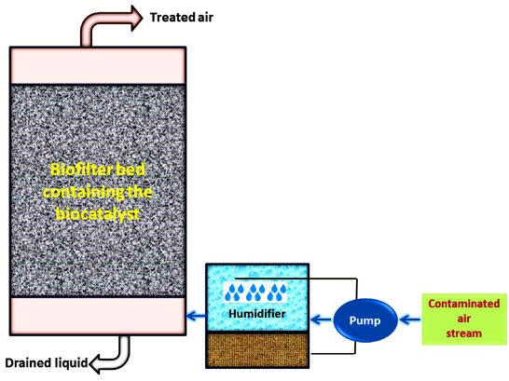
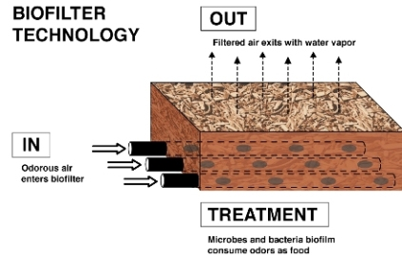
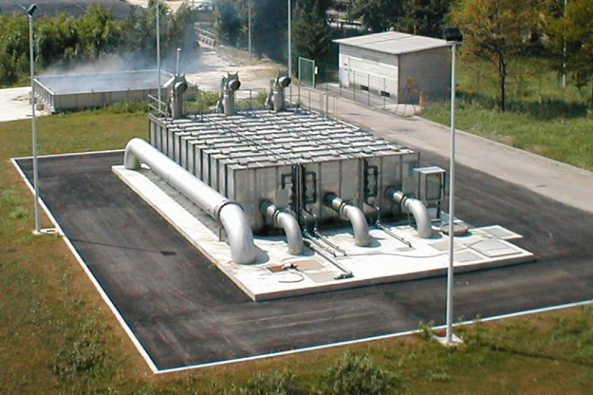
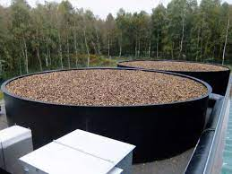

Slide 21



Bio-pesticides
Bio-pesticides are biological substances or organisms that can be used instead of chemicals for pest control and thus they overcome the negative effects of chemical pesticides.
The effective control of bio-pesticides requires appropriate formulation and application.
Bio-pesticides are majorly used in the area of soil amendments and seed treatments.
Micro-organism Bacillus thuringiensis stains use to kill insect larvae

Slide 22
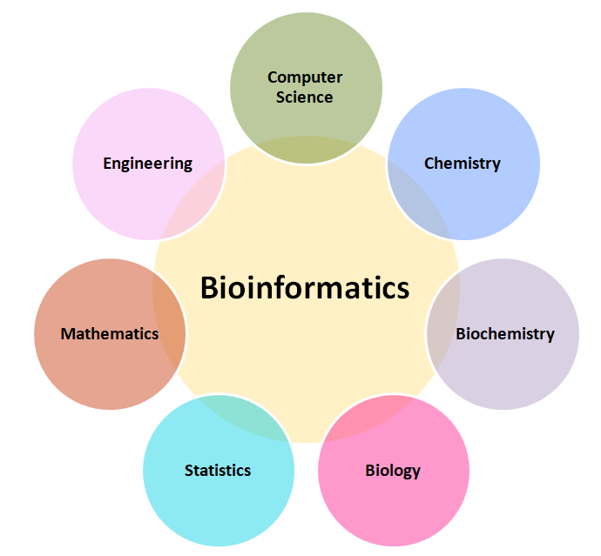
Bioinformatics
These are currently popular fields of study which are highly multi-disciplinary, and engineers can significantly contribute to those fields.
Those fields of study computationally analyze very large data sets to draw insights into the working of the fundamental functional unit of life - the cell.

Slide 23
Experience from previous batches
The subject helped them understand the structure and functions of living organisms, along with basic biological processes. Many students found topics like genetics, human physiology, and environmental science engaging and relatable to real life. Overall, Biology enhanced their scientific thinking and awareness about health and the environment.
Loria Sinha 4th year student
It was not just about theory, but also about understanding life processes and their applications in daily life. Students appreciated how the subject improved their observation and analytical skills. Over time, they realized that Biology plays an important role in fields like healthcare, biotechnology, and environmental sustainability, making it a valuable learning experience.
Satvik Shukla, 3th year student

Slide 24
Thank you....

